Slide 1
RECENT EFFORTS TOWARDS EFFICIENT AND SCALABLE NEURAL WAVEFORM CODING
Kai Zhen
Ph.D. Candidate in Computer Science and Cognitive Science
Research Committee:
Minje Kim, Robert Goldstone, Donald Williamson, Shen Yi

Slide 2
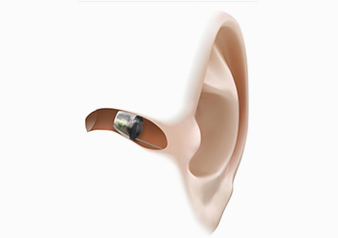
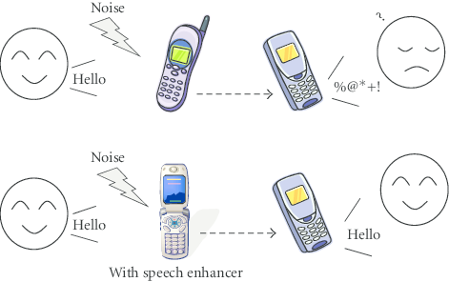
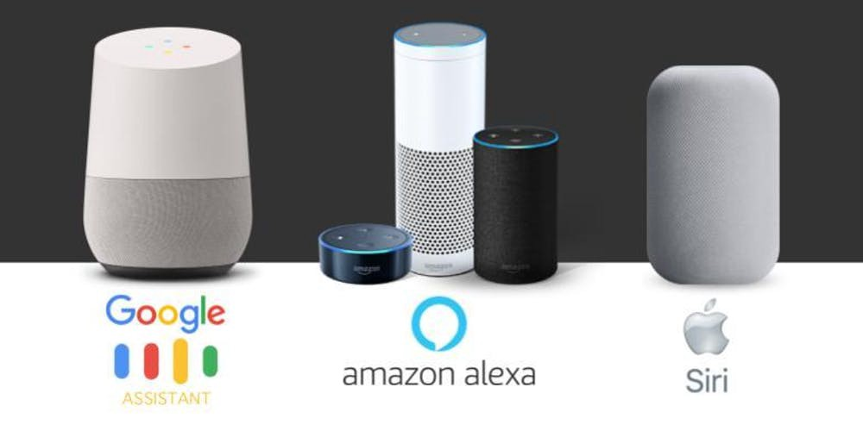

Acoustic Signal Processing in Intelligent Systems
s

Slide 3
Speech/Audio Coding in One Slide

Slide 4
The Opportunity, Challenge, and Approach
Need to support various bitrates: from ~9kbps to ~24kbps
Scalability
DSP
Pre-emphasis
Linear predictive coding (LPC)
Perceptual weighting
Residual coding
Machine learning
End-to-end speech coding neural network [1]
Residual learning
Soft-to-hard quantization [2]
Sub-pixel upsampling network [3]
Oops, my phone battery is drained after decoding a high quality audio message…
Lightweight
Bridge the gap between machine learning and DSP

Slide 5
The Structure of the Talk
Neural Quantization
Cross-Module Residual Learning
Perceptual Loss

Slide 6
The Structure of the Talk
Neural Quantization
Conventional DSP Techniques
Perceptual Loss
Soft-to-hard quantization
Multistage vector quantization
Discrepancy in metrics
Cross-module residual learning
Linear predictive coding
Psychoacoustical calibration
Collaborative quantization
Human auditory perception

Slide 7
The Structure of the Talk
Neural Quantization
Conventional DSP Techniques
Perceptual Loss
Soft-to-hard quantization
Multistage vector quantization
Discrepancy in metrics
Cross-module residual learning
Linear predictive coding
Psychoacoustical calibration
Collaborative quantization
Human auditory perception

Slide 8
Neural Scalar Quantization
Why is autoencoder itself not enough?
Autoencoder reduces the size of the feature map
The encoder part of each AE still produces real-valued vectors
Without quantization, each real value is still represented by a 16-bit floating-point.
Jjhhhhh/
Quantizer
Stride 2
Stride 2
Sub-pixel
Bottleneck CNN
Bottleneck CNN
Bottleneck CNN
Sub-pixel
Bottleneck CNN
Hoffman coding,
bitstream transmission

Slide 9
Neural Scalar Quantization
How about conducting a clustering analysis?
K-means clustering with 128 kernels
Each real value from the encoder output will be represented by the closest kernel out of 128 candidates
It suffices to use not 16 bits but 8 bits to represent each real value.
2X more compression!
But, a clustering algorithm has no control over the kernel probabilities
If kernels are with highly uneven probabilities, the data can be further compressed through entropy coding!
Jjhhhhh/
Quantizer
Stride 2
Stride 2
Sub-pixel
Bottleneck CNN
Bottleneck CNN
Bottleneck CNN
Sub-pixel
Bottleneck CNN
Hoffman coding,
bitstream transmission

Slide 10
Neural Scalar Quantization
A trainable K-means clustering style quantization
The encoder part of each AE produces a real-valued vector
Soft-to-hard quantization is to convert it into a bitstring
The coding gain depends on the distribution of the code
Soft-to-hard quantization controls the entropy of the code distribution as a regularization term during optimization
Soft Assignment (Training Time)
(Training Time)
Hard Assignment (Test Time)
(Test Time)

Slide 11
Neural Scalar Quantization
Soft-to-hard quantization
The encoder part of each AE produces a real-valued vector
Soft-to-hard quantization is to convert it into a bitstring
The coding gain depends on the distribution of the code
Soft-to-hard quantization controls the entropy of the code distribution as a regularization term during optimization
Soft Assignment (Training Time)
(Training Time)
Hard Assignment (Test Time)
(Test Time)

Slide 12
Speech Coding Versus Audio Coding
Generative speech models versus psychoacoustics
Excellent
AAC
HE-AAC
MPEG-2 BC
HE-AAC V2
MPEG-1
AMR-WB+
Good
AMR-WB
Normal
AMR
Subjective Quality
G.729
Poor
Bad
10k
24k
Bitrate

Slide 13
Cross-Module Residual Learning
Overview
So, does it work?
Decoder
Decoder
Decoder
BP for
BP for
BP for
Code Layer
Residual signal
Code Layer
Residual signal
Code Layer
Encoder
Encoder
Encoder
The 1st module
The 2nd module
The N^{th} module
Interspeech 2019

Slide 14
Background
Cross-Module Residual Learning
The baseline CMRL architecture
Jjhhhhh/
Softmax quantizer
Stride 2
Stride 2
Sub-pixel
Bottleneck CNN
Bottleneck CNN
Bottleneck CNN
Sub-pixel
Bottleneck CNN
Hoffman coding,
bitstream transmission

Slide 15
Cross-Module Residual Learning
The fully-convolutional architecture
The code vector
256X1
512X1
9X100X1
512X50
256X100
Identity shortcut
Identity shortcut
x2
512X20
9X20X100
256X20
512X20
x2
9X20X20
256X20
512X50
Sub-pixel convolution (Upsampling)
9X100X20
256X100
Quantization & Huffman coding
256X100
Downsampling
Interlacing two feature maps (256X2) to build one map of 512
9X100X100
Stride=2
512X100
256X100
x2
9X20X100
512X20
256X20
x2
Identity shortcut
9X20X20
512X20
256X20
9X100X20
512X100
Identity shortcut
256X100
9X1X100
512X1
256X1
S. Kankanahalli, “End-to-end optimized speech coding with deep neural network,” ICASSP 2018; Interspeech 2019
512X1

Slide 16
The Take Away from CMRL
The solution from multiple lightweight models can be better than that from a big one with the combined complexity.
Decoder
Decoder
Decoder
BP for
BP for
BP for
Code Layer
Residual signal
Code Layer
Residual signal
Code Layer
Encoder
Encoder
Encoder
The 1st module
The 2nd module
The N^{th} module

Slide 17
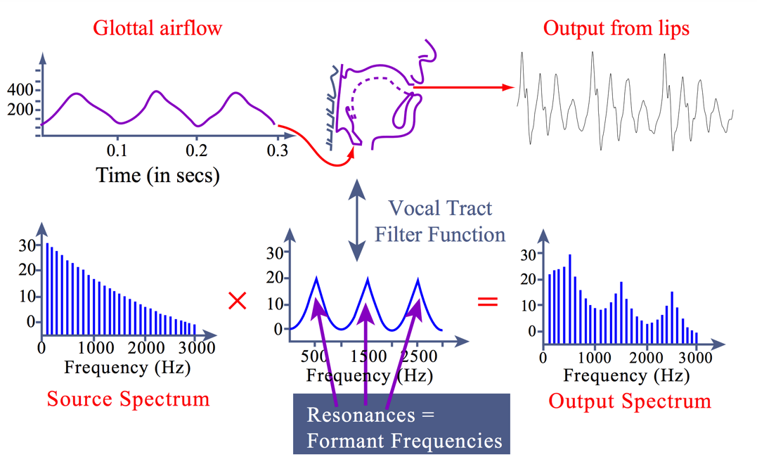
Don’t Throw DSP Out with the Bathwater
Why model the the entire speech with DNNs?
In source-filter model, the speech production process contains
Sources
glottal source, aspiration source, frication source, and transient source
Filter
The response of the vocal tract
https://ocw.mit.edu/courses/linguistics-and-philosophy/24-915-linguistic-phonetics-fall-2015/lecture-notes/MIT24_915F15_lec4.pdf

Slide 18
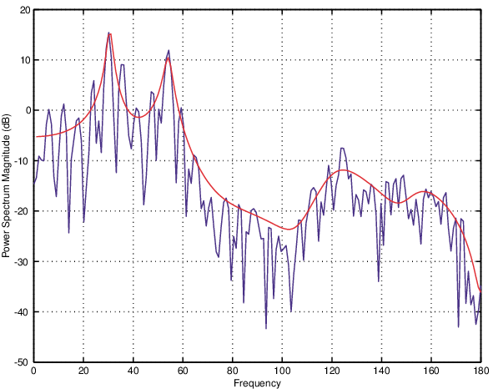
Linear Predictive Coding
LPC models the vocal tract response
With Levinson-Durbin algorithm, the spectral envelope is estimated with very few amount of bits,
Of course, the estimation is not perfect; the “error” is called the LPC residual.
C. I. Byrnes, P. Enqvist, A. Lindquist, Identifiability And Well-Posedness Of Shaping-Filter Parameterizations: A Global Analysis Approach

Slide 19
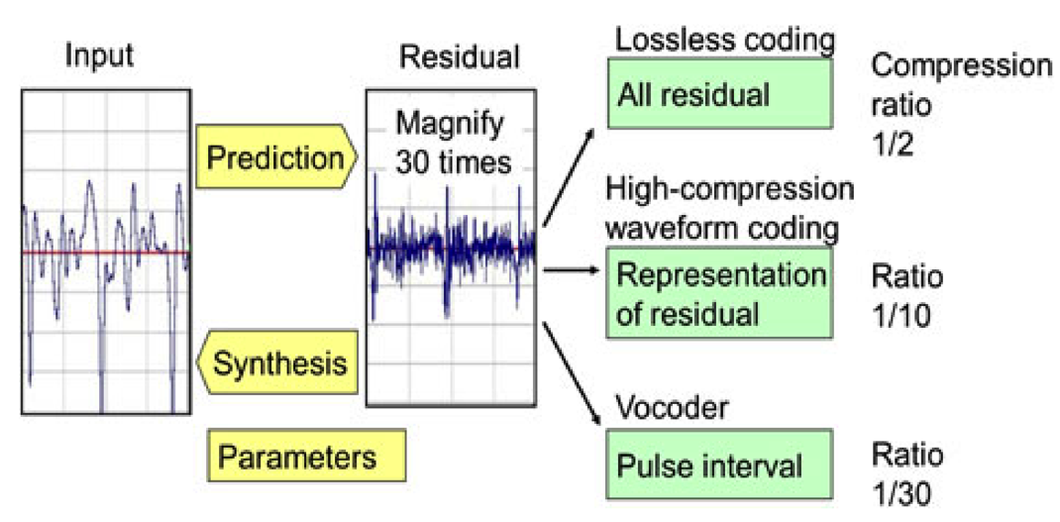
LPC in Coding Systems
s
T. Moriya, et al, Progress in LPC-based frequency-domain audio coding

Slide 20
An Easy Incremental Work?
Cross-Module Residual Learning
Cross-module residual learning (CMRL)
CMRL opened a new possibility of introducing residual coding to neural speech coding
It showed superior performance by concatenating multiple autoencoding modules as a chain of residual coding
More importantly, it turned out that having an LPC analysis-synthesis block as the 0-th module is effective
The 0-th LPC module
Learns the spectral envelope (formant information)
Borrow the LPC module from AMR-WB
Deterministic (not learnable)
Our goal in the proposed collaborative quantization (CQ) is to harmonize LPC as a learnable block, at least the quantization part
The CMRL architecture

Slide 21
Collaborative Quantization
A trainable quantization scheme for LPC coefficients
the criterion used for the computation and quantization of the LPC parameters is minimization of the residual signal energy
Raw waveform
Residual waveform
High-pass filter
Calculate LPC residuals
Pre-emphasis filter
LPC coefficients quantization
Coded LPC
Coefficients
Calculate LPC coefficients
(regularization)
C. I. Byrnes, P. Enqvist, A. Lindquist, Identifiability And Well-Posedness Of Shaping-Filter Parameterizations: A Global Analysis Approach

Slide 22

Cross-Module Residual Learning
Audio demo
Bitrate (kbps) | Reference | AMR-WB | OPUS | LPC+CMRL | LPC+CMLR +CQ
~9
~9
~24
~24
fasw/sa1.wav
ICASSP 2020; http://www.kaizhen.us/speechcoding.html

Slide 23
Performance
PESQ and MUSHRA
CQ shows reasonably better PESQ scores
Model complexity
CQ improves the CMRL baseline in the low bitrates
CQ shows decent performance in the high bitrates
PESQ

Slide 24
The Structure of the Talk
Neural Quantization
Conventional DSP Techniques
Perceptual Loss
Soft-to-hard quantization
Multistage vector quantization
Discrepancy in metrics
Cross-module residual learning
Linear predictive coding
Psychoacoustical calibration
Collaborative quantization
Human auditory perception

Slide 25
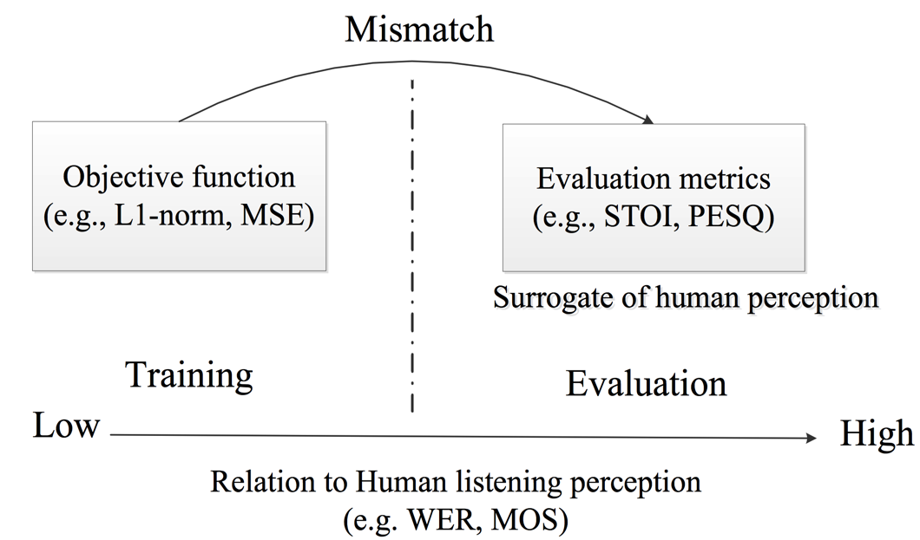
Objective Measures Do NOT Align
s
Actual mean opinion scores (MOS) for non-speech audio signals
S. W. Fu, et al, End-to-End Waveform Utterance Enhancement for Direct Evaluation Metrics Optimization by Fully Convolutional Neural Networks

Slide 26
Masking Effects from Psychoacoustics
s
Actual mean opinion scores (MOS) for non-speech audio signals
S. W. Fu, et al, End-to-End Waveform Utterance Enhancement for Direct Evaluation Metrics Optimization by Fully Convolutional Neural Networks

Slide 27
The Usage of the Masking Threshold in DNNs
Priority weighting
s
Actual mean opinion scores (MOS) for non-speech audio signals
S. W. Fu, et al, End-to-End Waveform Utterance Enhancement for Direct Evaluation Metrics Optimization by Fully Convolutional Neural Networks

Slide 28
The Usage of the Masking Threshold in DNNs
Noise Modulaiton
s
Actual mean opinion scores (MOS) for non-speech audio signals
S. W. Fu, et al, End-to-End Waveform Utterance Enhancement for Direct Evaluation Metrics Optimization by Fully Convolutional Neural Networks

Slide 29
The Usage of the Masking Threshold in DNNs
MUSHRA results
ssssss
sssss
S. W. Fu, et al, End-to-End Waveform Utterance Enhancement for Direct Evaluation Metrics Optimization by Fully Convolutional Neural Networks

Slide 30
The Usage of the Masking Threshold in DNNs
Noise Modulaiton
Bitrate (kbps) | Reference | AMR-WB | OPUS | LPC+CMRL | LPC+CMLR +CQ
~9
~9
~24
~24
s
S. W. Fu, et al, End-to-End Waveform Utterance Enhancement for Direct Evaluation Metrics Optimization by Fully Convolutional Neural Networks

Slide 31
The Structure of the Talk
Neural Quantization
Conventional DSP Techniques
Perceptual Loss
Soft-to-hard quantization
Multistage vector quantization
Discrepancy in metrics
Cross-module residual learning
Linear predictive coding
Psychoacoustical calibration
Collaborative quantization
Human auditory perception

Slide 32
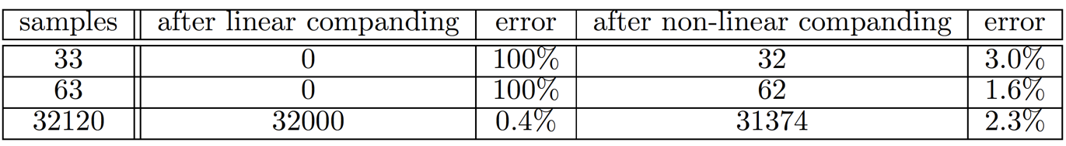
- law companding
Compress and expand the bit depth
Scenario
Transmitting a telephone audio signal
Compress the bit-depth from 16-bit to 8-bit per sample
Expand the bit-depth from 8-bit to 16-bit per sample
If it is linearly companded,
The amount of quantization error for samples with small amplitudes is the same with that for high-amplitude ones.
All samples with the amplitude from 0 to 255 will be rounded down to 0.
Notes:
>>> 32120/256
125
>>> 125*256
32000

Slide 33
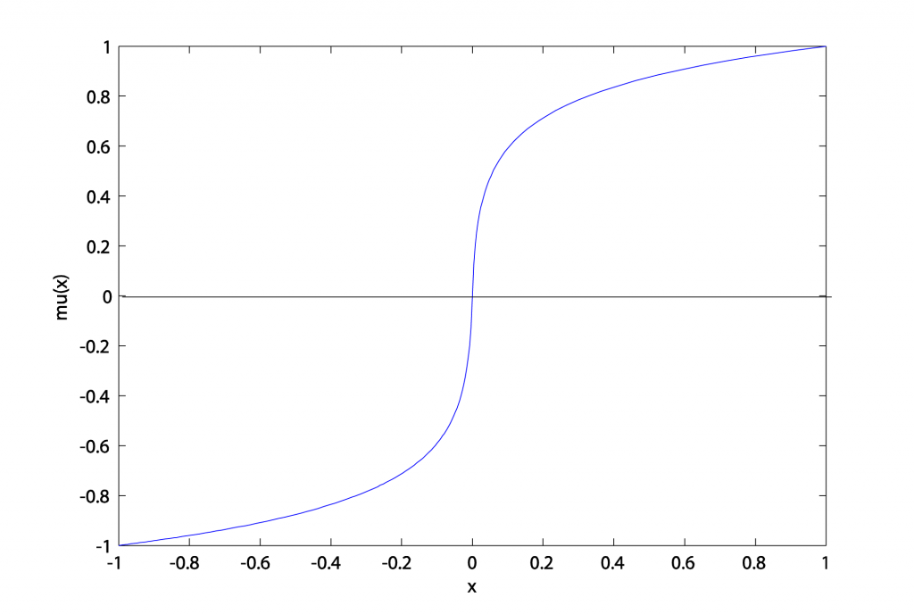
- law companding
More quantization levels for smaller values
Compression
mu(33/32768) = 0.0412;
floor(128*0.0412) = 5;
Expansion
mu_inv(5/128) = .00094846
ceil(32768* .00094846) = 32

Slide 34
- law companding
Can it be used to weigh the MSE loss term?
Interestingly, the kernels “learned” from our neural quantizer reflect the flavor of - law companding
More quantization levels for smaller values.
Rethink the mean-squared error
The data:
The estimate-1:
The estimate-2:
Equivalent MSE, but should they be considered the same?
Distribution of 32 learned
quantization bins in the AE modules

Slide 35
Wave-U-Net Quantization
Can a Wave-U-Net be used for coding?
A plain autoencoder with identical shortcuts
Popular for image segmentation, audio separation, speech enhancement, etc.
Have been used in audio coding, but
Add/Concat
Add/Concat
Add/Concat

Slide 36
Wave-U-Net Quantization
From identical shortcuts to approximated shortcuts
More observations can be acquired from empirical results
May not need the bottleneck
Dynamic bit allocation for identical shortcuts
Less bits for the one near the bottleneck
May not even need to quantize all shortcuts
1
1
2
2
3
3

Slide 37
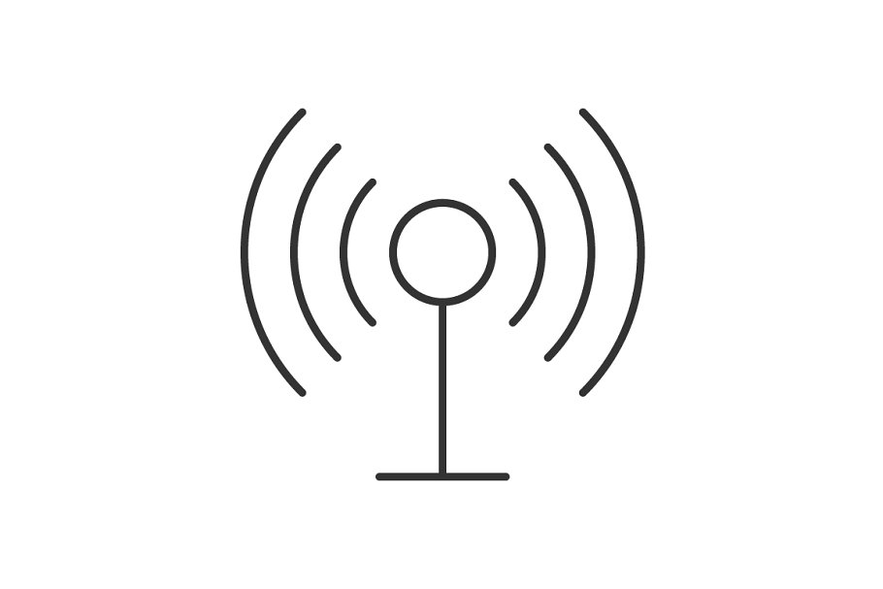
Wave-U-Net Quantization
From scalar quantization to vector quantization
The current Softmax quantiztion is scalar-based
Temporal pattern not utilized
How about a trainable VQ
The code is just the index
Soft Assignment (Training Time)
(Training Time)
Embedding dictionary
Embedding dictionary
Calculate the distance
argmin
Get the index
Hard Assignment (Test Time)
(Test Time)
A. V. D. Oord, et al, Neural Discrete Representation Learning

Slide 38
Cross-Module Residual Learning
Soft-to-hard quantization and the loss function
Time-domain sample-by-sample reconstruction
May not be the best
Spectral reconstruction
In the mel-scale
Entropy loss
Reducing entropy of the code can increase the coding gain
Original bitrate: (256*5)*16000/(512-32)+2400 = 45kbps
Huffman codding reduces the bitrate further
Soft Assignment (Training Time)
(Training Time)
(Test Time)
Hard Assignment (Test Time)
(Normalized soft count)
Interspeech 2019

Slide 39
Collaborative Quantization
A trainable quantization scheme for LPC coefficients
In CMRL the LPC module from AMR-WB consumes 2.4kbpsWe want to do it better
Trainable LPC?
Too easy to estimate
But, quantization is a learnable part in neural coding!
6.45kbps
27%
Distribution of 32 learned quantization bins in the CMRL AE modules
2.4kbps
Speech Signal
Residual Frame
High-pass filter
Calculate LPC residuals
Pre-emphasis filter
LPC coefficients quantization
Coded LPC
Coefficients
Calculate LPC coefficients
Spikiness controlled by the entropy loss
(regularization)
ICASSP 2020

Slide 40
Background
Soft-to-hard quantization
The encoder part of each AE produces a real-valued vector
Soft-to-hard quantization is to convert it into a bitstring
The coding gain depends on the distribution of the code
Soft-to-hard quantization controls the entropy of the code distribution as a regularization term during optimization
Soft Assignment (Training Time)
(Training Time)
Hard Assignment (Test Time)
(Test Time)

Slide 41
Background
The LPC module
Speech Signal
Residual Frame
High-pass filter
Calculate LPC residuals
Pre-emphasis filter
LPC coefficients quantization
Coded LPC
Coefficients
Calculate LPC coefficients
(regularization)
We implement a basic LPC module in TensorFlow
There are some implementation details about the choice of the windows

Slide 42
Trainable LPC Quantization
Soft-to-hard quantization for LPC coefficients
Soft-to-hard quantization adjusts the distribution of the codes to maximize the coding gain
Entropy regularization
Histogram of initial 16 LPC coefficients
Distribution of 32 learned
quantization bins in the AE modules

Slide 43
Overview of the CQ system
Trainable LPC quantization + CMRL

Slide 44
Collaborative Quantization
MUSHRA
Complexity
CQ improves the CMRL baseline in the low bitrates
CQ shows decent performance in the high bitrates
0
20
40
60
80
100
0
20
40
60
80
100
Reference
Reference
LPC-CMRL 16 kbps
CQ 24 kbps
CQ 9 kbps
LPC-CMRL 24 kbps
AMR-WB 8.85 kbps
OPUS 24 kbps
LPC-CMRL 9 kbps
OPUS 9 kbps
AMR-WB 23.85 kbps
Anchor (4kHz )
Anchor (4kHz )
ICASSP 2020

